Slide 1

DnA Realty:
A Real Estate Office Database
Anuraag Dasari and Dhanush Annoji
Database Systems Project
(realty)

Slide 2
What does the application do?
Search the market: One flexible property search answers every “what’s for sale?” question: by city, district, price, beds, or pool.
Record sales: Staff record a sale against a listed home; the office’s reports update instantly.
Track agent performance: Per-agent totals, average sale price, and average days on market for any year.
Manage the office: Add agents and keep buyer/seller records.

Slide 3
Architecture
Split into:
app.py: Tkinter GUI
db.py: data layer
schema.sql + seed.py: schema definition and sample data
realestate.db: the SQLite database file

Slide 4
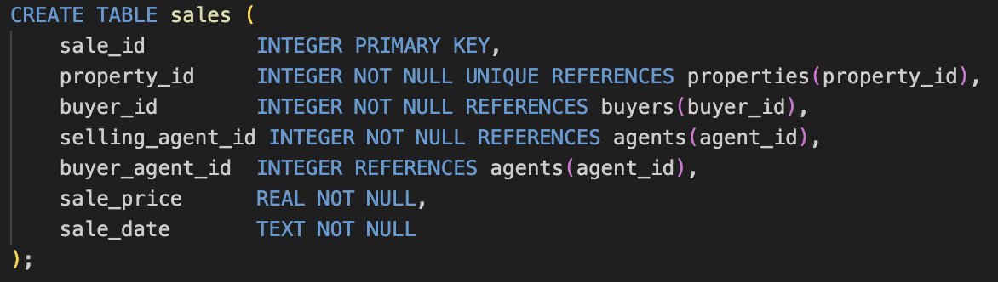
The data model:
schema.sql:
sales.property_id is UNIQUE, a home sells at most once.
“For sale” is derived: a property with no sales row is on the market. No status flag to forget to update.
Five relations:
agents: agent_id
sellers: seller_id
buyers: buyer_id
properties: property_id
sales: sale_id

Slide 5
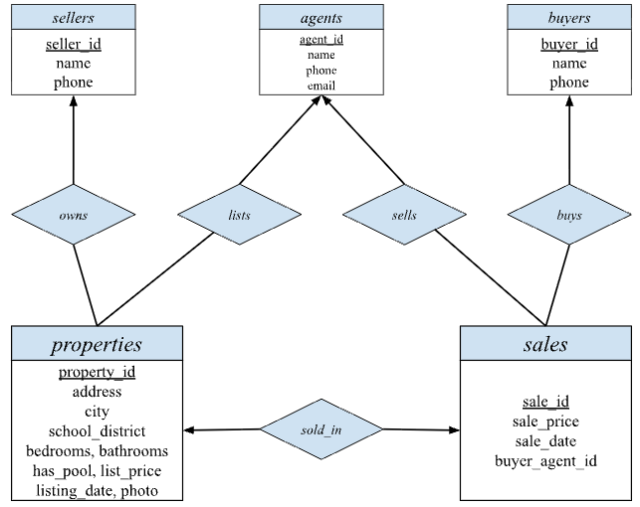
E-R Diagram

Slide 6
E-R Diagram Cont.
Entities: agents, sellers, buyers, properties, sales
Attributes: agents: agent_id (PK), name, phone, email; sellers: seller_id (PK), name, phone; buyers: buyer_id (PK), name, phone; properties: property_id (PK), address, city, school_district, bedrooms, bathrooms, has_pool, list_price, listing_date, photo; sales: sale_id (PK), sale_price, sale_date
Relationships/Cardinality: owns (sellers–properties): one-to-many.; lists (agents–properties): one-to-many.; sells (agents–sales): one-to-many.; buys (buyers–sales): one-to-many.; sold_in (properties–sales): one-to-one.
Participation: properties in owns, lists, sales in sells, buys, sold_in: total; properties in sold_in: partial (a property need not be sold, it can be "for sale" with no sale row); sellers, agents, buyers: partial in their relationships (a seller/agent/buyer may exist without any linked property or sale).
Roles: An agent plays two roles: the selling agent (sells relationship, selling_agent_id) and the buyer's agent (buyer_agent_id, optional)

Slide 7
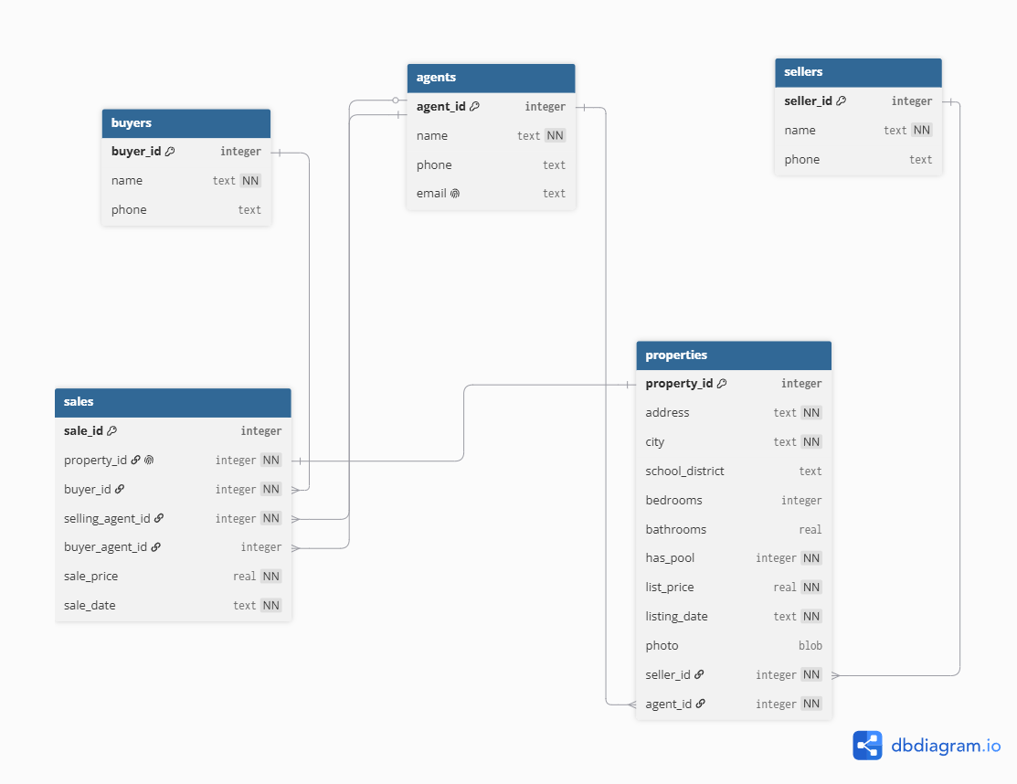
Relational Schema

Slide 8
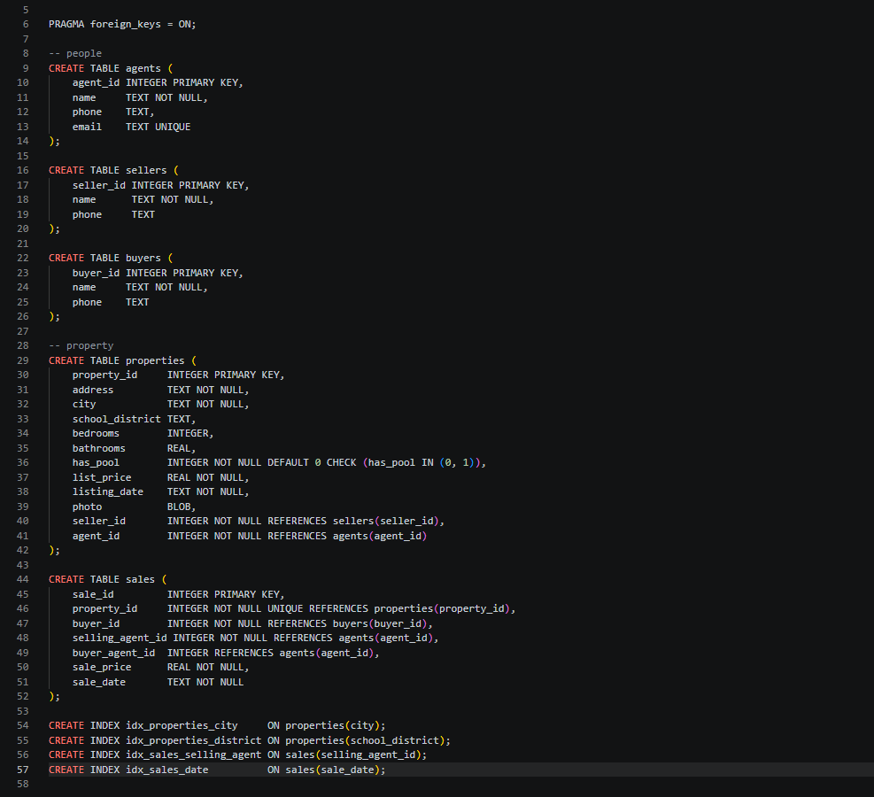
Relational Schema:

Slide 9
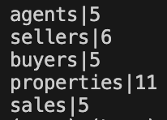
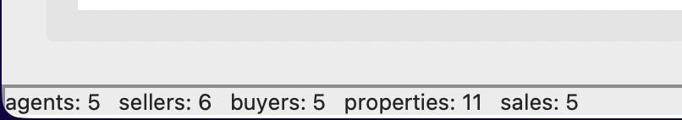
Table Counts

Slide 10
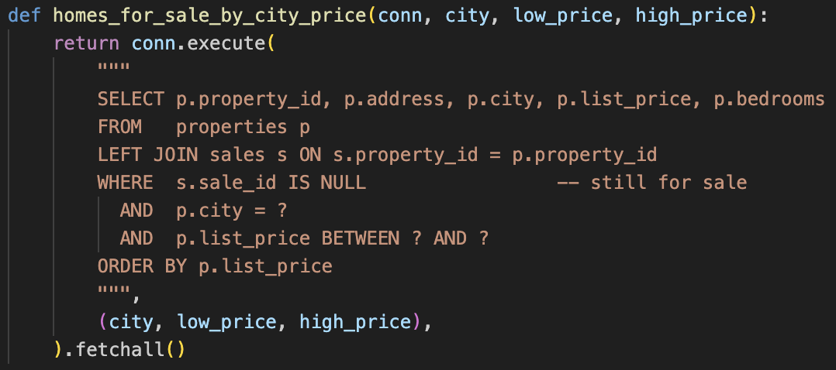
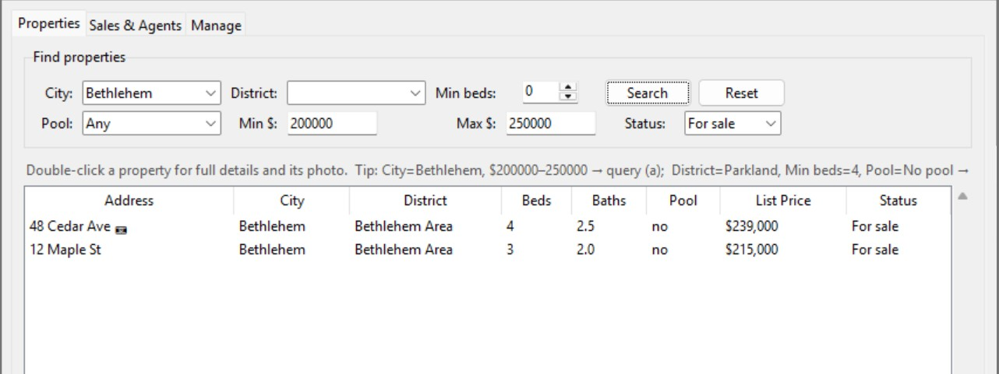
Query (A):
Find addresses of homes for sale in the city “Bethlehem” costing between $200,000 and $250,000.
48 Cedar Ave and 12 Maple St.

Slide 11
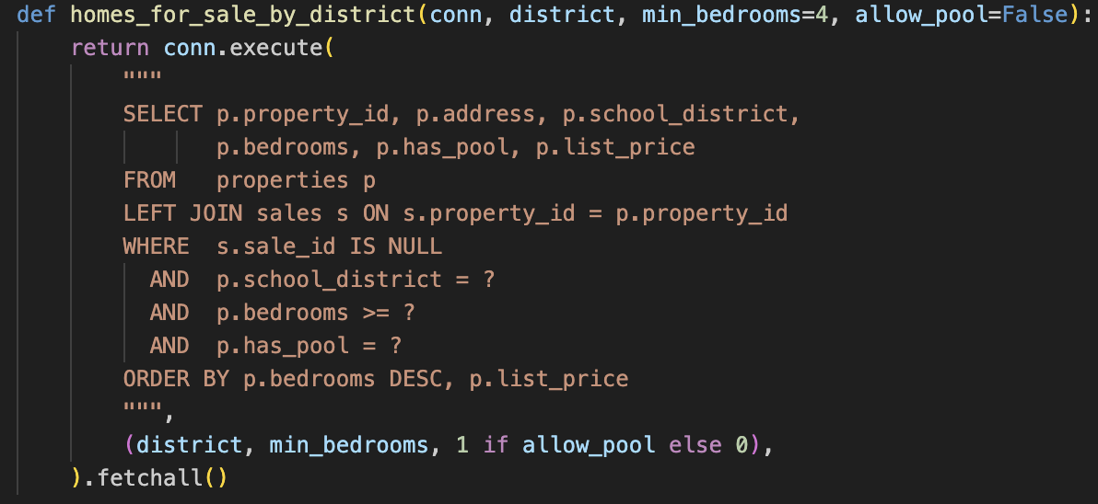
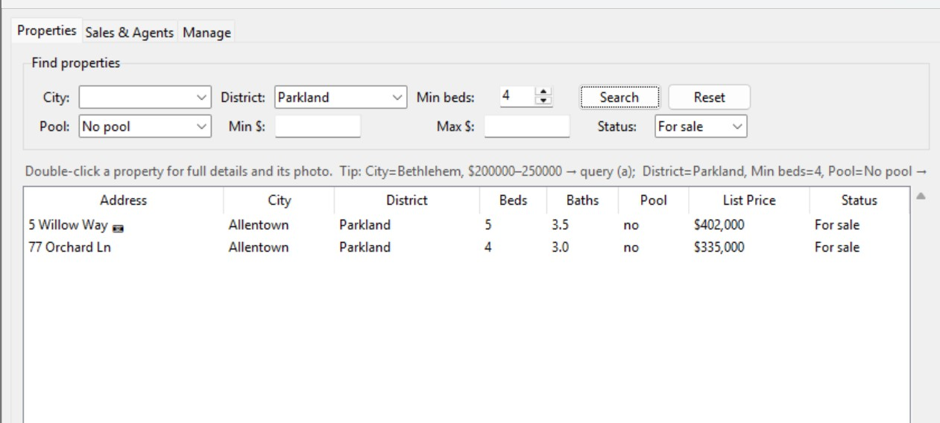
Query (B)
Find addresses of homes for sale in the school district “Parkland” with 4 or more bedrooms and no swimming pool.
5 Willow Way (5 bed) and 77 Orchard Ln (4 bed).

Slide 12
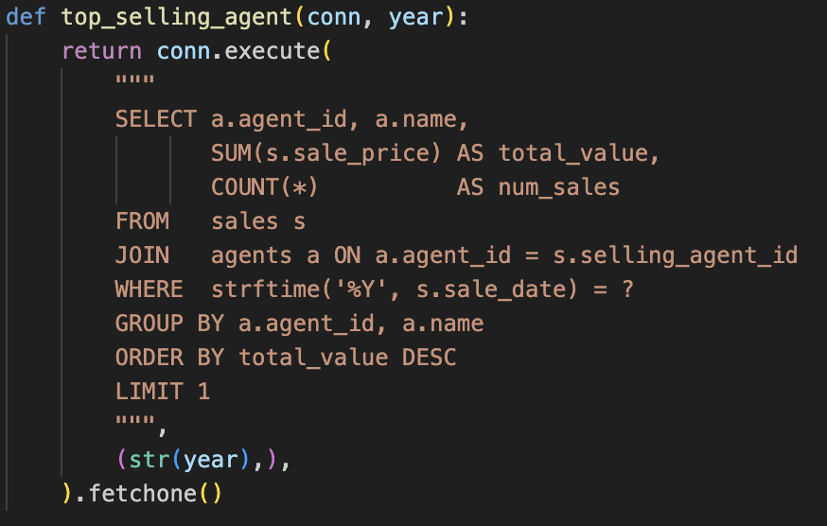
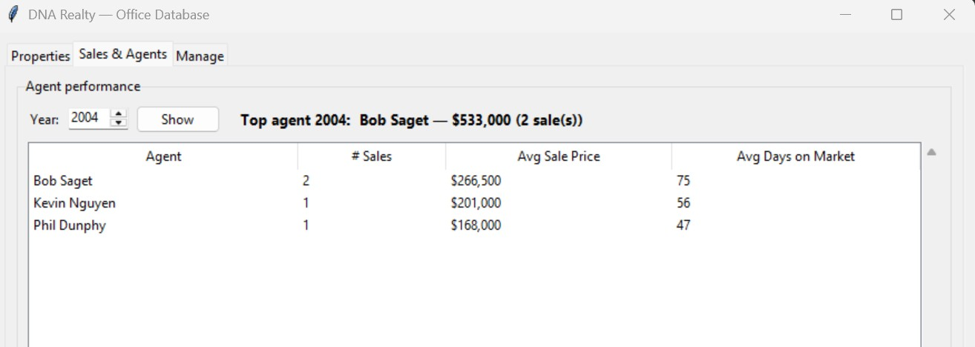
Query (C)
Find the name of the agent who has sold the most property in the year 2004 by total dollar value.
Bob Saget

Slide 13
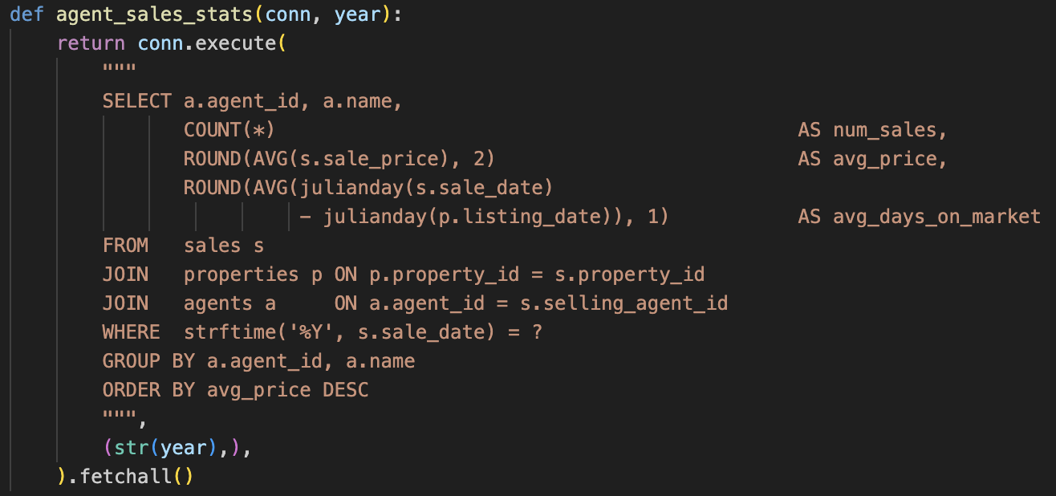
Query (D)
For each agent, compute the average selling price of properties sold in 2004, and the average time the property was on the market.
Bob Saget: 2 sales, avg $266,500, 75 days; Kevin Nguyen: 1 sale, avg $201,000, 56 days; Phil Dunphy: 1 sale, avg $168,000, 47 days.

Slide 14
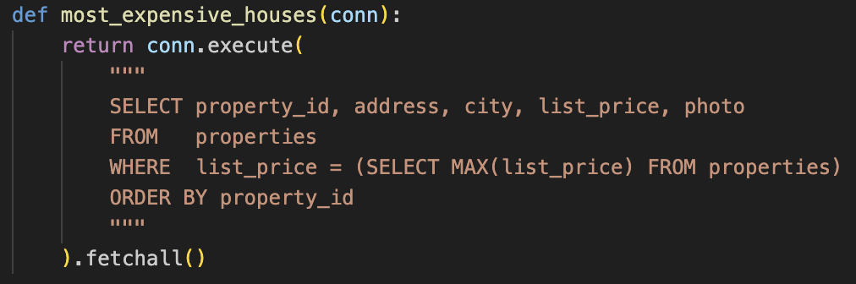
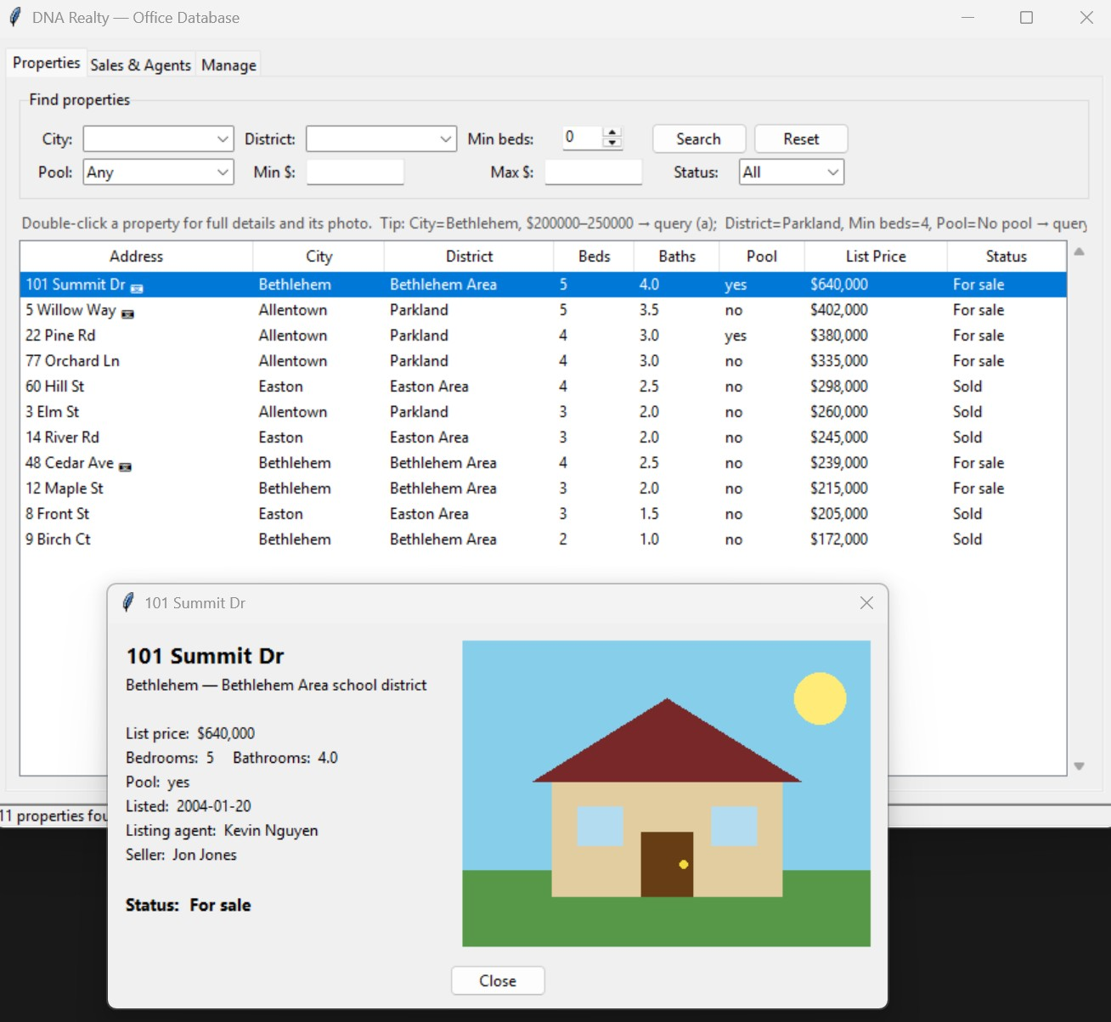
Query (E)
Show a picture of the most expensive house(s) in the database.
101 Summit Dr, Bethlehem: $640,000 (has a photo BLOB; the GUI renders it)

Slide 15
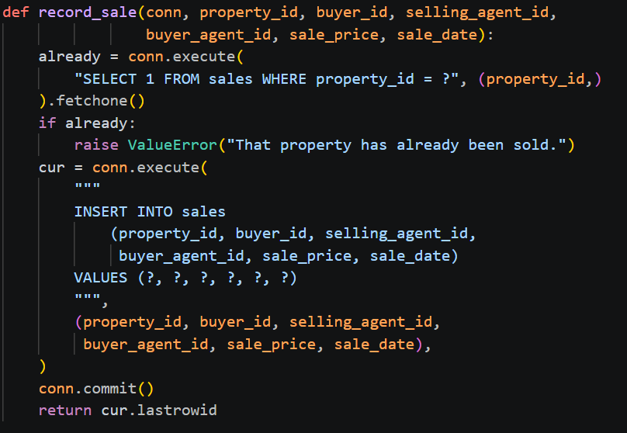
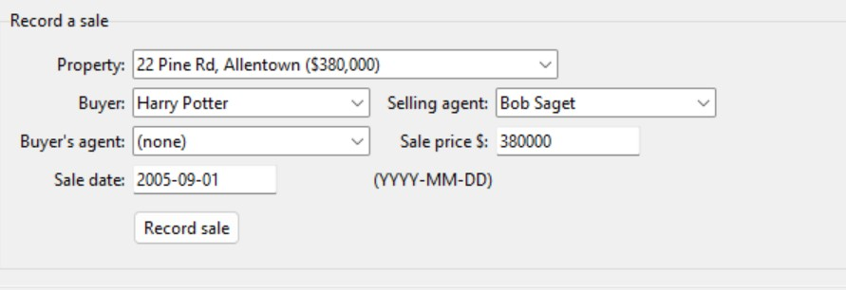
Query (F)
Record the sale of a property that had been listed as being available. This entails storing the sales price, the buyer, the selling agent, the buyer’s agent (if any), and the date.
22 Pine Rd, Allentown to Harry Potter, selling agent Bob Saget, no buyer's agent, $380,000 on 2005-09-01 inserts a new sales row and the property drops out of the "for sale" list.

Slide 16
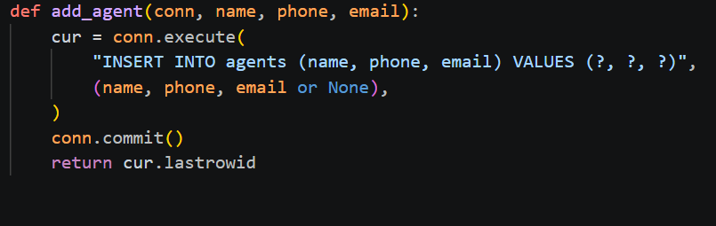
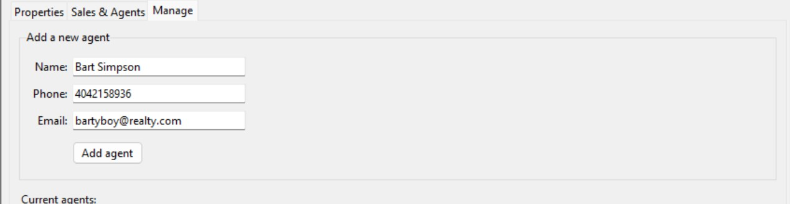
Query (G)
Add a new agent to the database.
Adding Bart Simpson, 4042158936, bartyboy@realty.com, inserts a new agents row that then appears in the Current agents list.

Slide 17
Summary:
A complete real-estate database
Clean separation of concerns
Good schema
Every required query

